Slide 1

Personal Loan Campaign Modeling
Tanisha Kapoor
NiveditaChaudhari
CoderGirl Data Science
11 August 2021

Slide 2
Brief Overview
Dataset Used : “Personal Loan Modeling” which is available on Kaggle.
There are 14 features (independent variables) and 1 target (dependent) variable for 5000 customers.
Target variable (Personal_Loan) indicates whether customer accepted personal loan offered in the last campaign or not.
Problem Type : Binary classification problem as the target variable has two classes (1/0)
Objective
To build a machine learning model which can predict:
Whether a liability customer will buy a personal loan or not.
Which variables are most significant.
Which segment of customers should be targeted more.

Slide 3
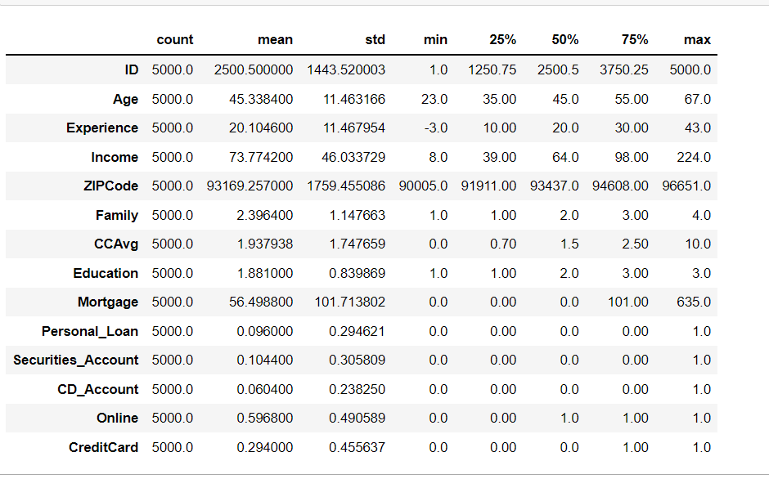
Data Description
Average age of customer in given data set is 45.34
Average experience of customers in years is 20.10 years. But experience Variable has -ve values which is not correct, this need to be fixed
Average income of customer in dollars is 73.77K
Average family size is 2.4
Average amount spent by customer on credit cart in dollars is 1.93K
On an average most of the customer are Under graduate or graduate
Average house loan customer availed in dollars is 56.5K
For variables: Income, CCAvg, Experience, Mortgage, Security_Account, CD_Accounts, CreditCard has big difference between mean Vs Max values, which suggest that there are some extreme values or possible outliers

Slide 4
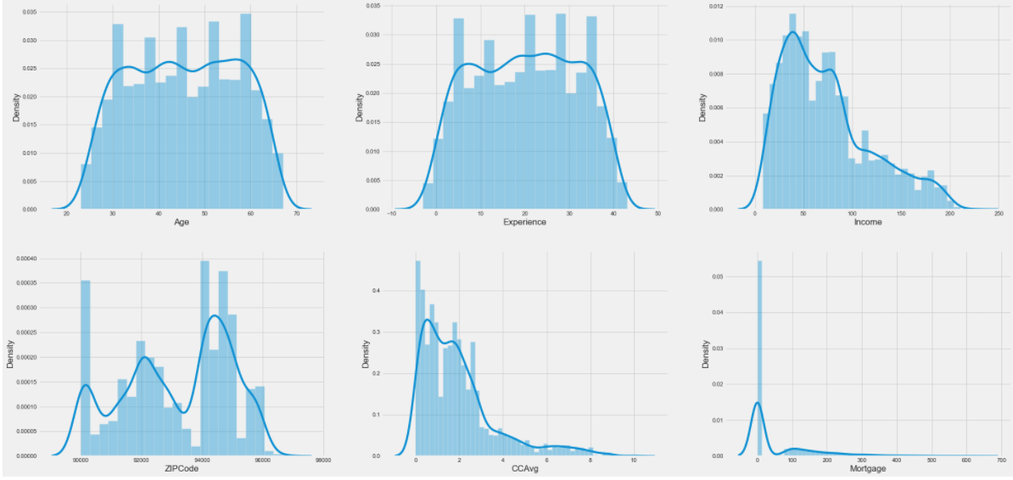
EDA : Univariate Analysis of Continous Variables
Age variable is normally distributed with majority of customers falling between 30 years and 60 years of age.
Average experience customers has in years is around 20years.
Experience variable has some negative value which should be fixed. It is normally distributed.
Income is right skewed.Therefore, income mean(73.77) is higher than median(64)
CCAvg is right skewed having mean higher than it’s median.
Mortgage contains most of the values as zero. It also contains many outliers.

Slide 5
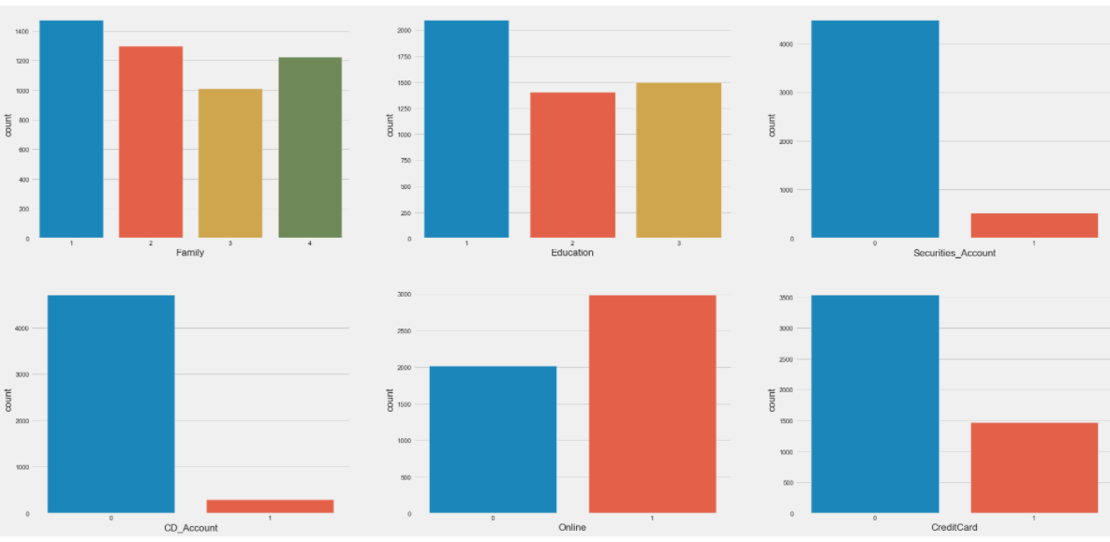
EDA: Univariate Analysis of Categorical Variables
Family size for most of the customers is 1
Education level for most of the customers is Undergraduate(1=Undergaduate, 2=Grduate, 3=Advance)
Most of the customer don't have CD_Account, Credit Card and Securities_Account
Customers are interested in using Online banking

Slide 6
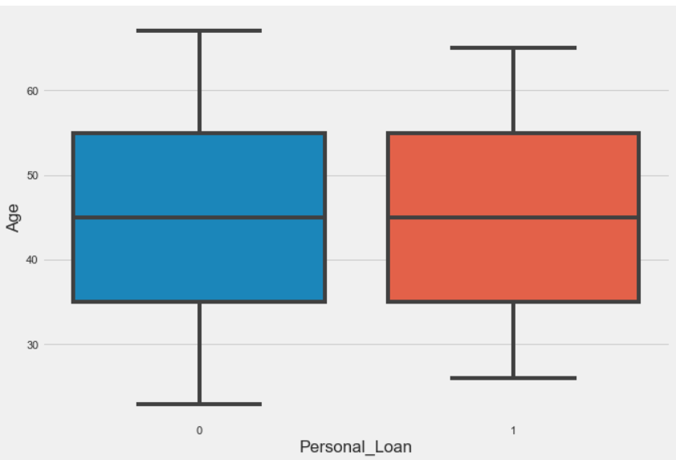
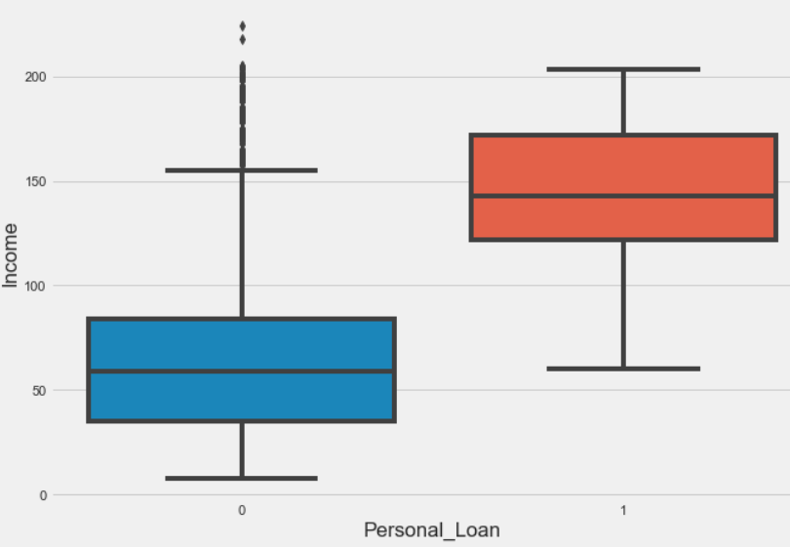
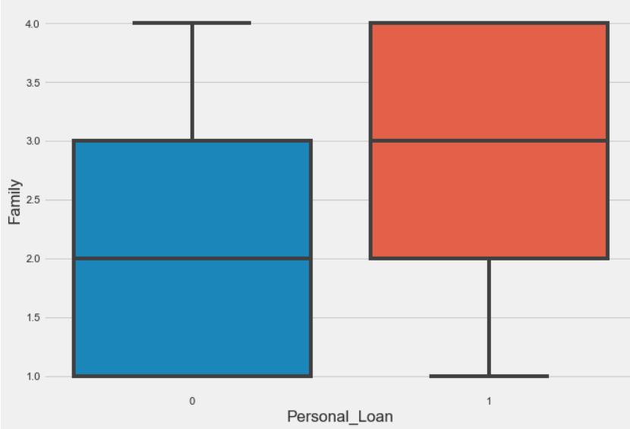
Bi-Variate Analysis
Personal Loan Vs Age, Income and Family
Observation :
Personal Loan doesn't show variations with Age.
Observation :
Income variable seems to have good effect on Personal_Loan.
As income level of customers is increasing ,they are more interested in taking loan.
Observation:
Customers have better chance of accepting personal loan when the family size is more than or equal to three.

Slide 7
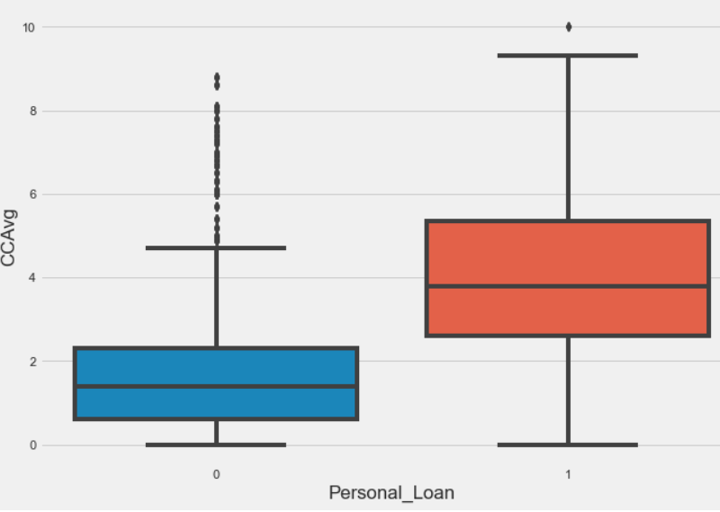
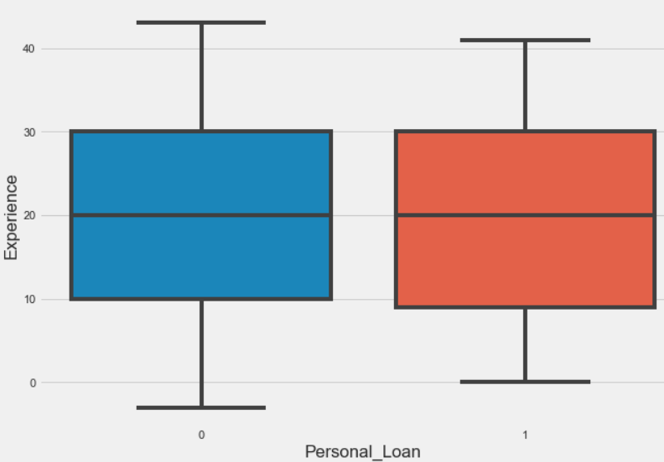
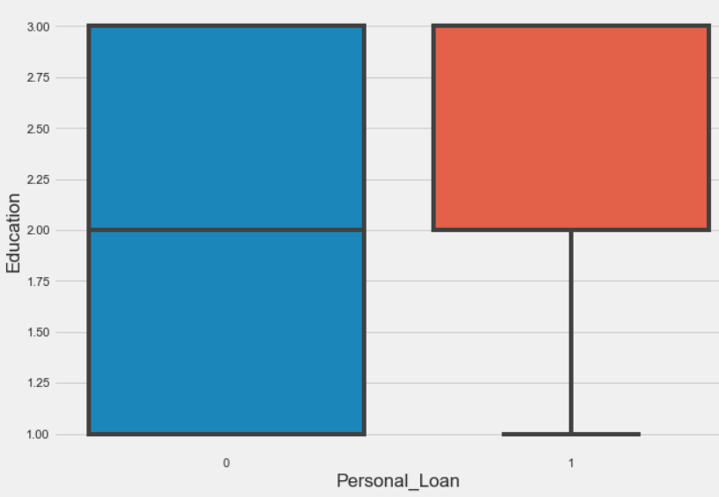
Bi-Variate Analysis
Personal Loan Vs CCAvg, Experience and Education
Observation :
CCAvg show good relationship with Personal Loan.
Customer who has more spending on Credit cards has more chances to have personal loan.
Observation :
Personal Loan doesn't show much variations with Experience.
Observation :
Customer with higher education levels, especially customer who are Graduate or Advanced professionals have more chances.

Slide 8
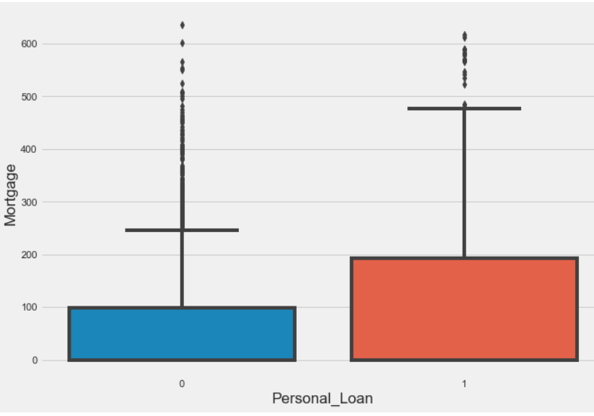
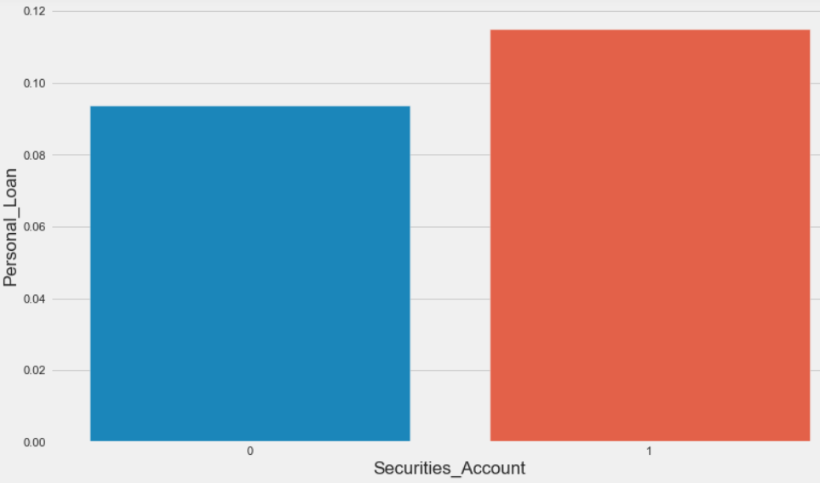
Bi-Variate Analysis
Personal Loan Vs Mortgage & Security Accounts
Observation :
Customer with more mortgage value have higher chance of accepting personal loan.
Observation :
Customer with Securities account has high chance of having personal loan in comparison to customer with no securities account.

Slide 9
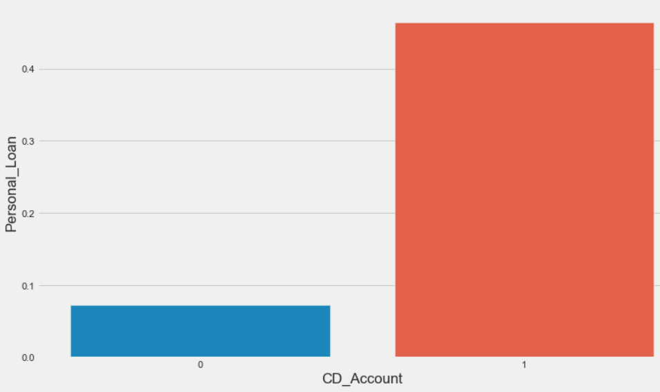
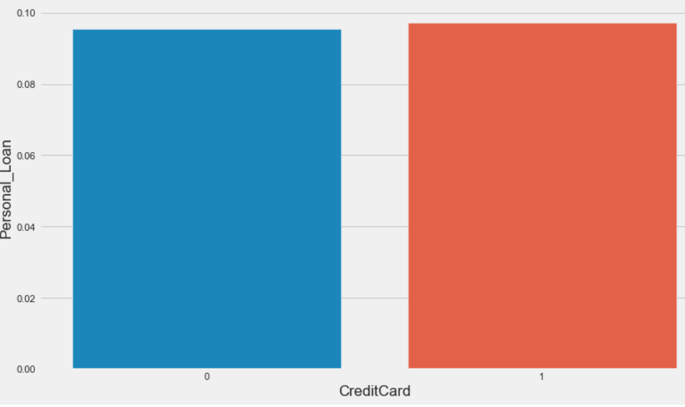
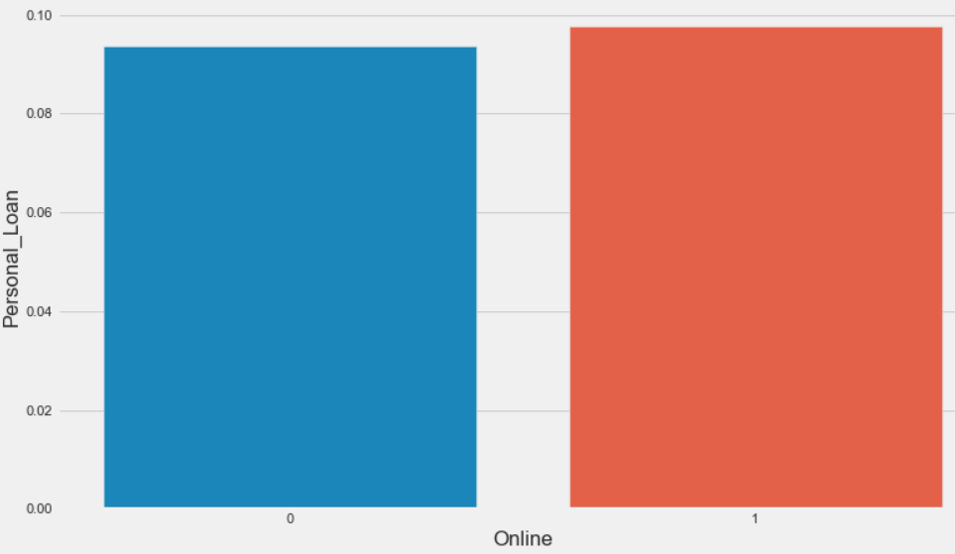
Bi-Variate Analysis
Personal Loan Vs CD Account ,Credit Card and Online
CD_Account | Credit Card | Online
Observation: Customer with CD account has high chance of having personal loan in comparison to customer with no CD account | Observation: Customers having Credit card or not doesn't have much impact on chances of customer having personal loan | Observation: Customers using online banking or not doesn't have much impact on chances of customer having personal loan

Slide 10
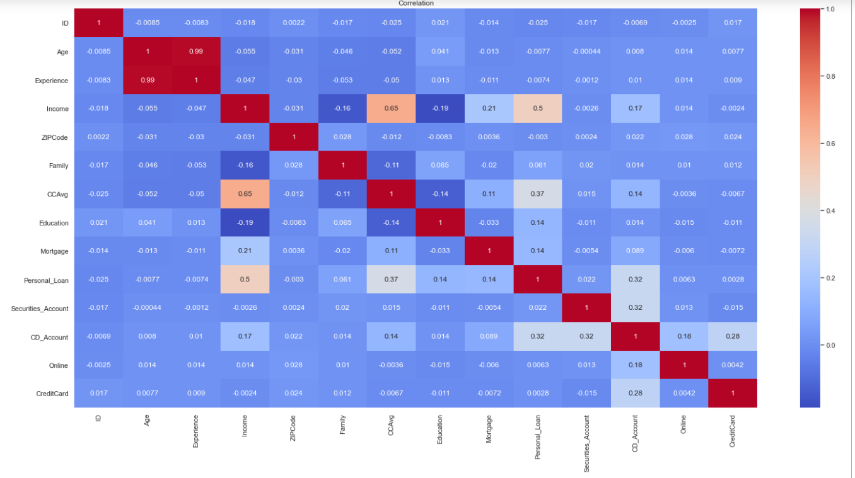
Exploratory Data Analysis- Correlation Matrix
Observations :
Personal_Loan has high correlation with Income, Credit card average spending(CCAvg) and CD_Account.
In other variables we see high correlation between Age and experience of 0.99.These 2 variables can have multicollinearity.
Income and CCAvg are highly correlated with each other at 0.65.
Personal loan doesn't seems to have any major correlation with experience.
Income and CCAvg have a positive correlation with Mortgage.

Slide 11
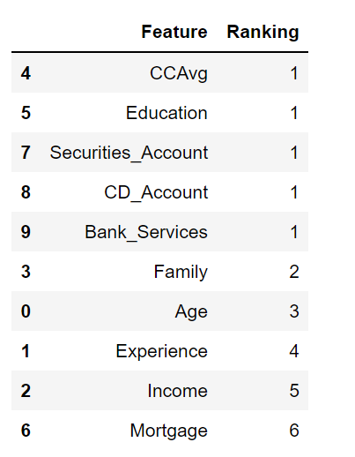
Data Check, Cleaning and Feature Engineering
Data Cleaning:
Duplicates entries where checked in data set and no duplicate rows were found which indicates Data is clean
Zip code was dropped as it doesn’t had any significant impact on target variable
ID also doesn’t had any significant impact on Personal loan, so it was used as Index for Data Frame
Removed outliers from Income,CCAvg, Mortgage and Age variables using IQR
Feature Engineering:
New Feature Bank_Services was used:
Variable Bank_Services was created combining Online and Credit card Variable & correlation with Personal loan was checked
New variable had better correlation with personal loan as compared to online and Credit card, so we dropped Online & CreditCard
Multicollinearity Check using VIF :(Variance –Inflation factor)
Experience and Age had very high VIF value as they were highly correlated
Experience was dropped as it had –ve enteries and also age was more
better at predicting the target variable
Feature Selection:
Selected features using RFE technique
RFE ranking showed CCAvg, Education, Securities Account, CD_Account
and Bank_Services as the most important features.

Slide 12
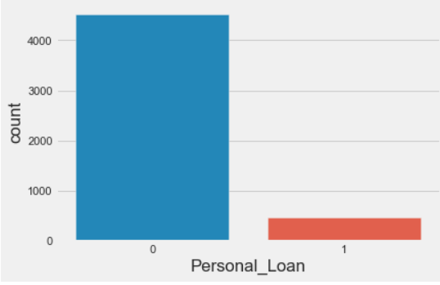
Modeling
We would be analyzing the following models:
Logistic Regression
K-Nearest Neighbours
Decision Trees Classifier
Random Forest Classifier
Xgboost Classifier
Evaluation Metric :
Recall would be our evaluation metric as we would not like to miss customer who wanted
to take personal loan but was identified as not interested customer by the model.
This would be a huge loss for the bank.
The whole purpose of the campaign was to target such customers.
Modeling Steps:
Identify the Dependent and Independent variables. Personal Loan will be dependent/target variable in our case
Split the Data into Train and test
Standardize the data using StandardScaler
Model Building
Evaluating model performance using different metrics
Target Visualization :
Target variable(Personal_Loan) has highly imbalanced class distribution.
Negative class (Personal_Loan=0) is much high than
positive class (Personal_Loan=1).
Imbalanced class distributions influence the performance of a machine
learning model negatively.
We used oversampling techniques to overcome this issue
like ROS, Smote, Smoteen.

Slide 13
Logistic Regression
Logistic Regression Overview :
Logistic regression is kind of like linear regression, but is used when the dependent variable is not a number but something else (e.g., a "yes/no" response).
It's called regression but performs classification based on the regression and it classifies the dependent variable into either of the classes.
Reasons for choosing :
Efficiency to train the model.
l1 and l2 regularization techniques, prevented the model from overfitting.
Operating and running the model was also a very simple, effective, and interpretable.
Random Over Sampling techniques used for handling class imbalance in the target variable.
Different variations :
LR_Model_1 (Without balancing the classes)
LR_Model_2 ( Hyperparameter Tuning and handling Class Imbalance )
LR_Model_3 (Using subset of features)
Observations on these models:
LR_Model_1:
Recall was low when classes were not balanced.
LR_Model_2:
Recall was good when the classes(0,1) in target variable(Personal_Loan) were balanced and hypertuning was applied. Also, False Negatives were quiet low.AUC score in this case was 0.97 which suggested model is good at predicting the two classes
LR_Model_3:
Recall was not good when used only some features.AUC score in this case was 0.87 which meant the model was not so good at predicting target class accurately.
Logistic Regression-Model Conclusion:
Model built after handling class imbalance and hyperparameter tuning was more reliable. Therefore, we would be considering this model for further analysis.

Slide 14
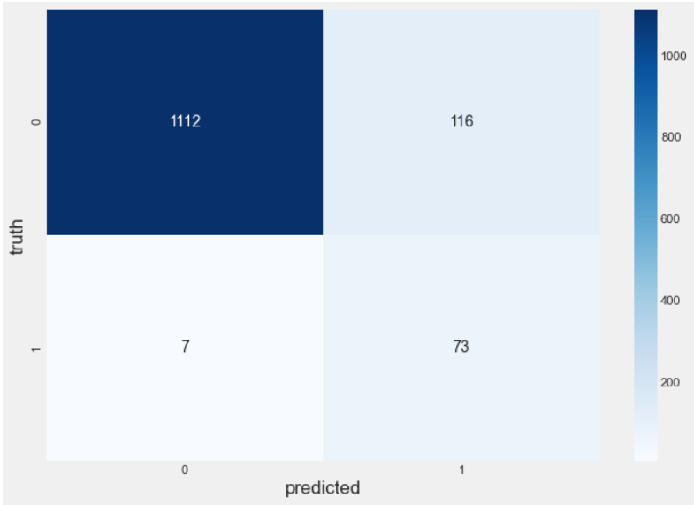
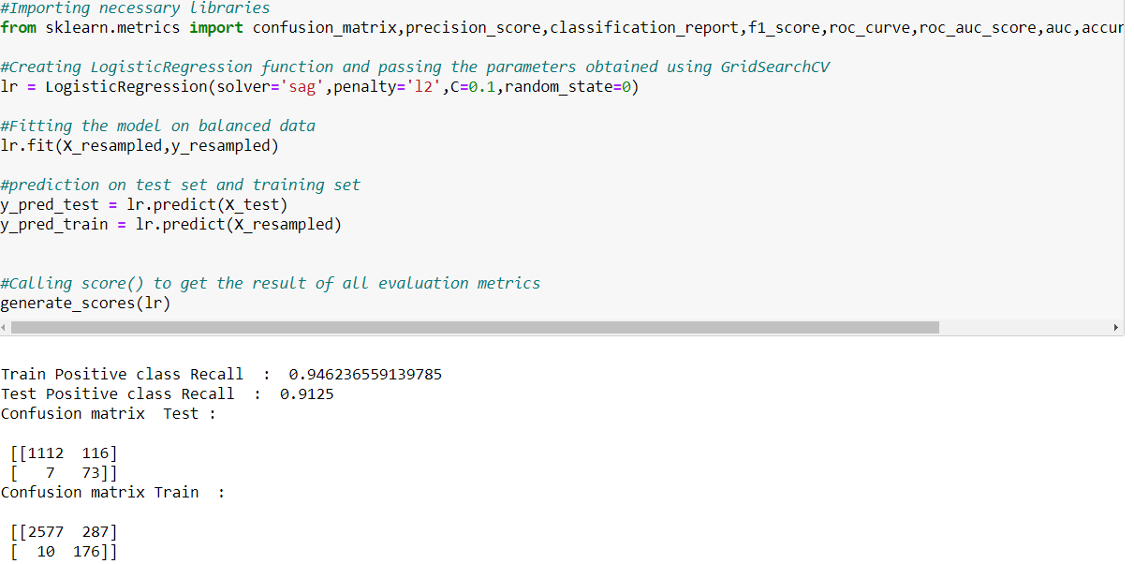
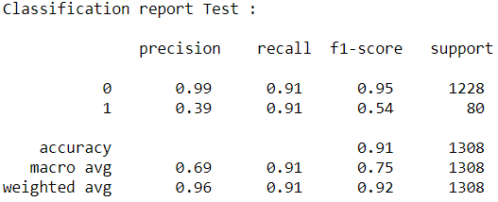
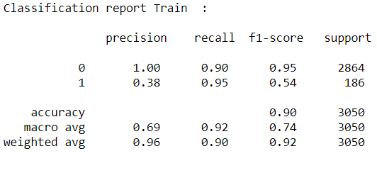
Logistic Regression Model- Confusion Matrix
Interpretation of test confusion matrix:
Diagonal values represent accurate predictions, while non-diagonal predictions are not accurate. In the output, 1112 and 73 are actual predictions and 116and 7 are innacurate predictions.
True Positive from our matrix :73
True Negative from our matrix :1112
False Positive from our matrix :116
False Negative from our matrix :7
Recall :
Train Data : 0.94
Test Data :0.91
We can see that Recall for both Train and Test is same. . We can conclude there is no overfitting
Notes:
Prediction on Train Data Set
Prediction on Test Data Set

Slide 15
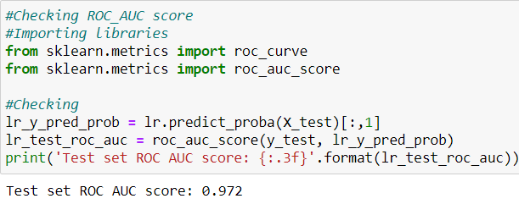
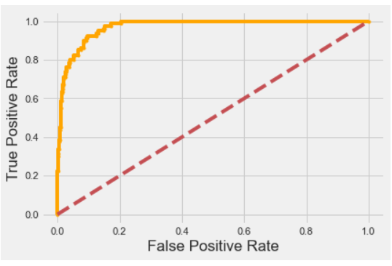
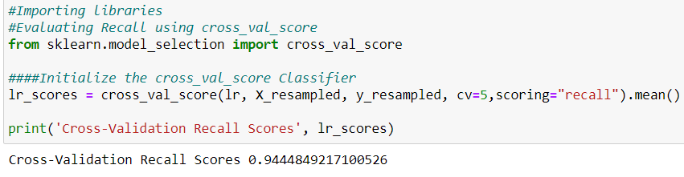
Logistic Regression Model
AUC ROC Curve and Cross Validation Score
From ROC curve we have value of 0.97, which means that our model is good at predicting.
Cross Validation Recall score :0.94

Slide 16
KNN MODEL
KNN Overview :
K-NN algorithm assumes the similarity between the new case/data and available cases and put the
new case into the category that is most similar to the available categories
K-NN algorithm can be used for Regression as well as for Classification problems
Reasons for choosing :
It’s easy to implement and tune
Only one hyper parameter to be set
Since it is doesn’t perform well on imbalanced data .Random Over Sampling techniques was used
for handling class imbalance in the target variable.
Different variations :
KNN_Model_1 (Finding Optimal k value manually)
KNN_Model_2 ( Hyperparameter Tuning )
Observations on these models:
KNN_Model_1 :
Recall value for both test and train are far apart.
KNN_Model_2:
Recall improved after hyperparameter tuning .
Also, False Negatives came down to 6.
AUC score in this case was 0.96 which suggested model is good at predicting the two classes.
KNN Model - Conclusion:
Model built after performing hyperparameter tuning was more reliable. Therefore, we would be considering
this model for further analysis.

Slide 17

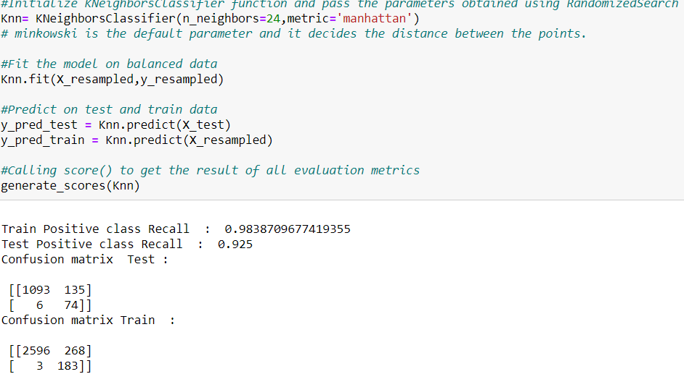
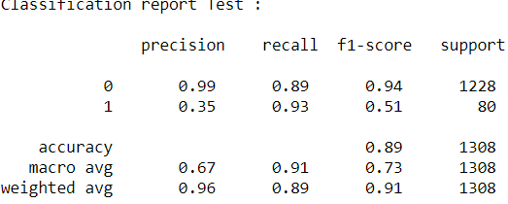
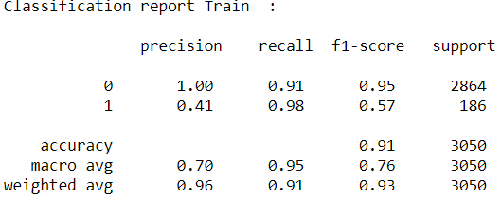
KNN Model – Confusion Matrix
Interpretation of test confusion matrix:
Diagonal values represent accurate predictions, while non-diagonal predictions are not accurate. In the output, 1093and 74 are actual predictions and 135 and 6 are innacurate predictions.
True Positive from our matrix :74
True Negative from our matrix 1093
False Positive from our matrix :135
False Negative from our matrix :6
Recall :
Train Data : 0.98
Test Data :0.92
We can see that Recall for both Train and Test are same. Hence, model build is not overfittting

Slide 18
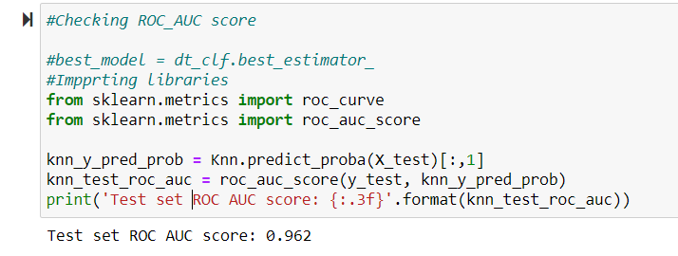
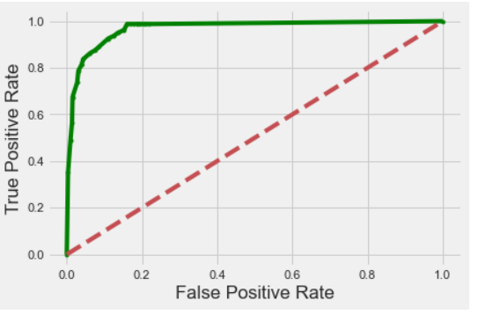
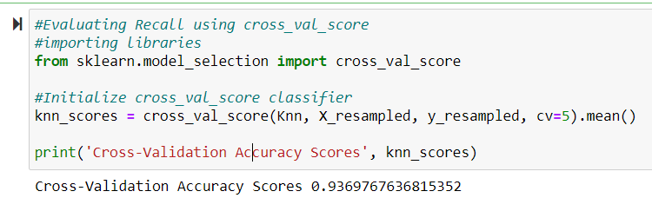
KNN Model- AUC ROC Curve and Cross Validation Score
From ROC curve we have value of 0.96 which means that our model is good at predicting.
Cross Validation Recall score :0.93

Slide 19
Decision Tree
Decision Tree Overview :
DT is a tree shaped diagram used to determine course of action.
Each branch of the tree represents a possible occurrence or reaction.
Reasons for choosing :
It requires reduced effort for data preparation during pre-processing
Model does not require scaling of data, nor does it require normalization. However these stages have already been accounted for, for accuracy purposes.
These models are extremely fast and inexpensive to construct
Different variations :
DT_Model_1 (Unoptimized + Class_weights)
DT_Model_2 (Hyperparameter Tuning using GridSearchCV )
Observation on these models:
DT_Model_1 (UnOptimized + Class_weights):
Recall Scores for train and test set were far apart
This suggests that the model is overfitting.
DT_Model_2(Hyperparameter Tuning using GridSearchCV )
Recall for test set has improved to 0.92 after hyperparameter tuning.
False Negatives is less.
AUC score is 0.92
DT Model - Conclusion:
Model built after performing hyperparameter tuning was more reliable. Therefore, we would be considering this model for further analysis.

Slide 20
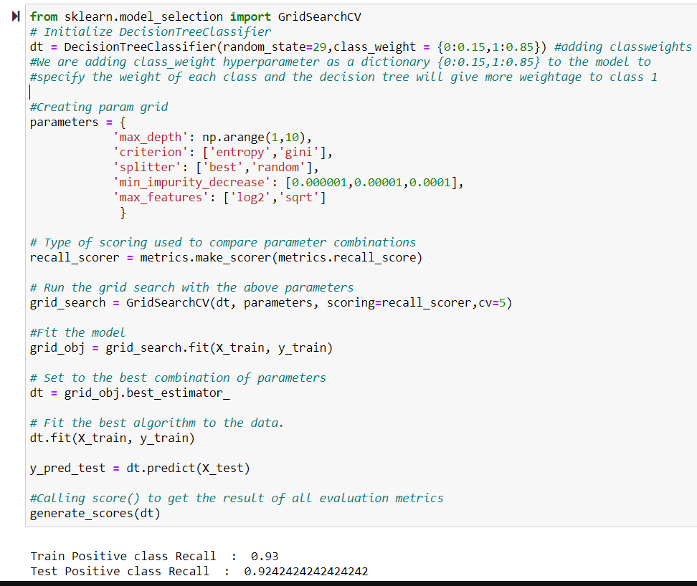
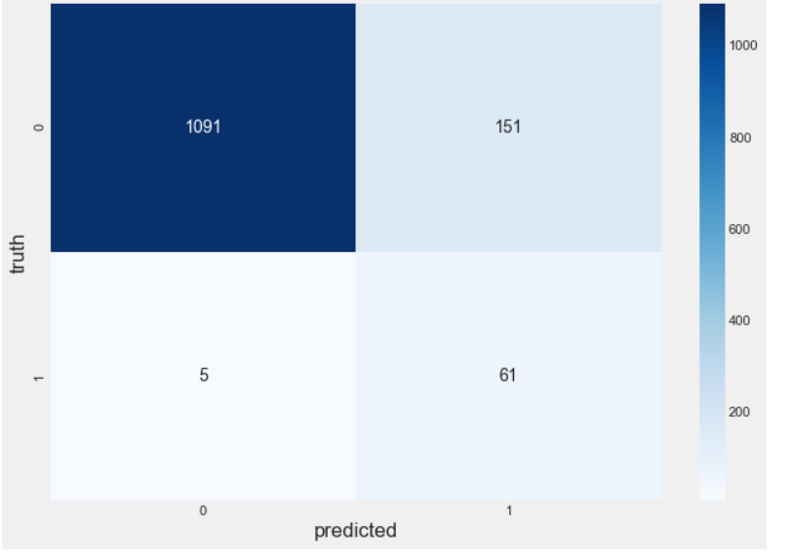
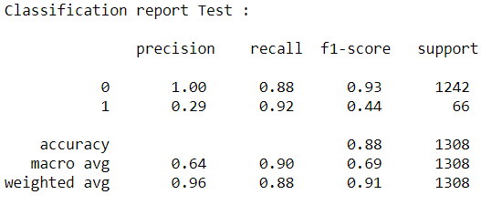
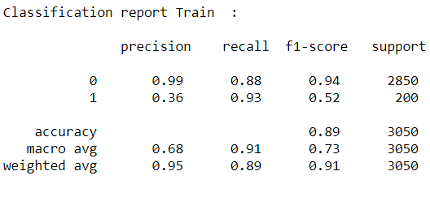
Decision Tree Confusion Matrix
Interpretation of confusion matrix:
Diagonal values represent accurate predictions, while non-diagonal predictions are not accurate. In the output, 1091and 61 are actual predictions and 151and 5 are innacurate predictions.
True Positive from our matrix :61
True Negative from our matrix :1091
False Positive from our matrix :151
False Negative from our matrix :5
Recall :
Train Data : 0.93
Test Data :0.92
We can see that Recall for both Train and Test are same. Hence, model build is not overfittting

Slide 21
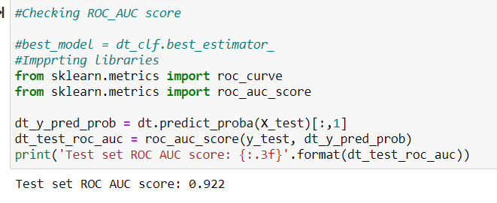
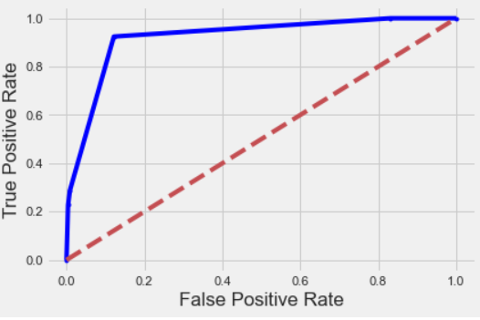
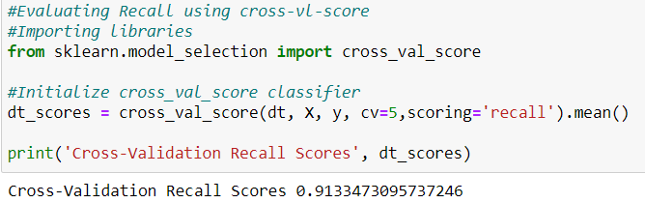
Decision Tree Model
AUC ROC Curve and Cross Validation
From ROC curve we have value of 0.922 which means that our model is good at predicting.
Cross Validation Recall score - 0.91

Slide 22
Random Forest
Random Forest Overview :
Random forest classifier is an ensemble algorithm based on bagging i.e bootstrap aggregation.
Ensemble methods combines more than one algorithm of the same or different kind for classifying objects
(i.e., an ensemble of SVM, naive Bayes or decision trees, for example.)
Reasons for choosing :
It provides higher accuracy through cross validation
Random forest classifier will handle the missing values and maintain the accuracy of a large proportion of data
Different variations :
RF_Model_1 (Unoptimized + RandomOverSampler )
RF_Model_2 (Hyperparameter Tuning + RandomOverSampler)
RF_Model_3 (Checking feature importance)
Observation on these models:
RF_Model_1 (UnOptimized + RandomOverSampler )
Recall Scores for train and test set were far apart
The model might be overfitted
RF_Model_2(Hyperparameter Tuning + RandomOverSampler)
Recall for test set has improved to 0.96 after hyperparameter tuning.
False Negatives dropped to 2
-AUC score is 0.99
RF_Model_3(Subset of features + RandomOverSampler):
Recall for test set is around 0.90 which is lower than hypertuned model.
RF Model - Conclusion:
Model built after performing hyperparameter tuning was more reliable. Therefore, we would be considering this model for further analysis.

Slide 23
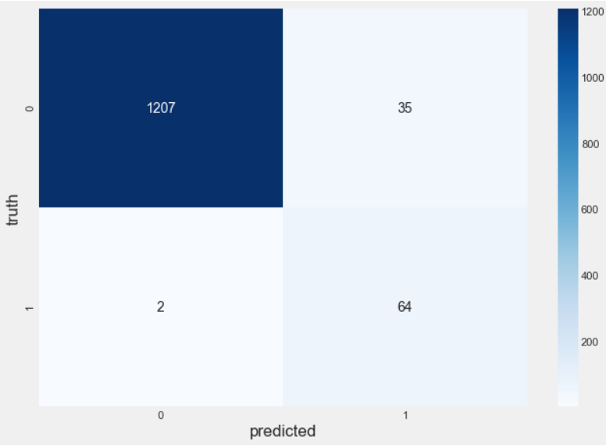
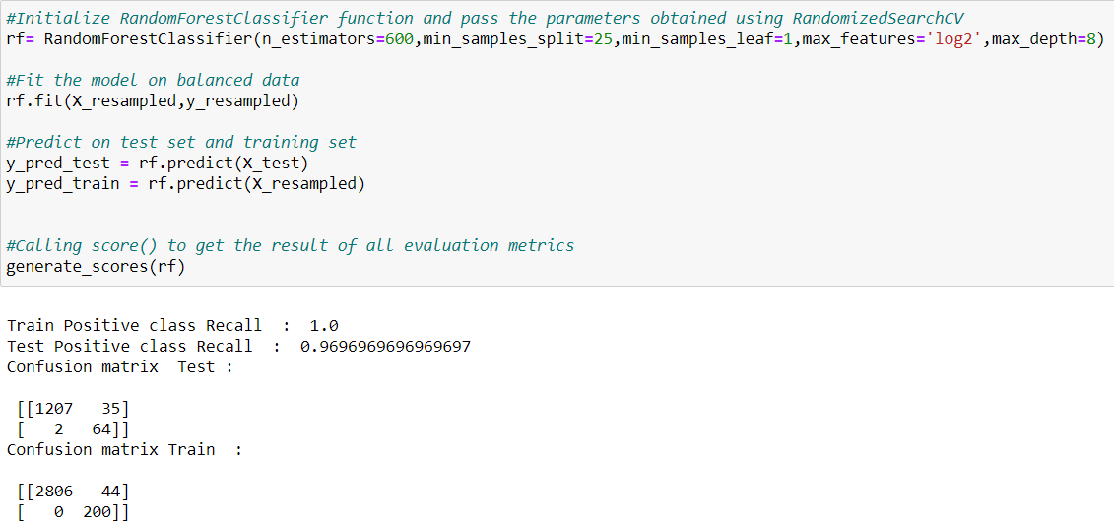
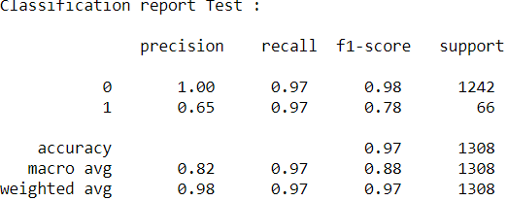
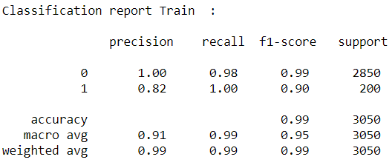
Random Forest Confusion Matrix
Interpretation of test confusion matrix:
Diagonal values represent accurate predictions, while non-diagonal predictions are not accurate. In the output, 1207and 64 are actual predictions and 35and 2 are innacurate predictions.
True Positive from our matrix :64
True Negative from our matrix 1207
False Positive from our matrix :35
False Negative from our matrix :2
Recall :
Train Data :1.0
Test Data :0.96
We can see that Recall for both Train and Test are same. Hence, model build is not overfittting

Slide 24
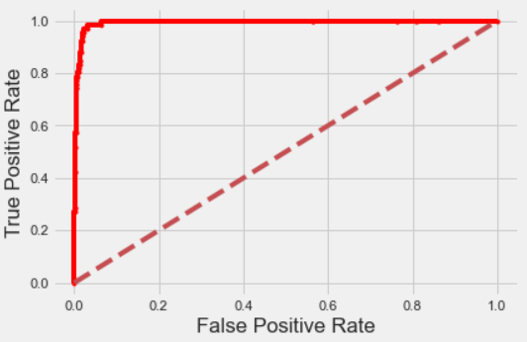
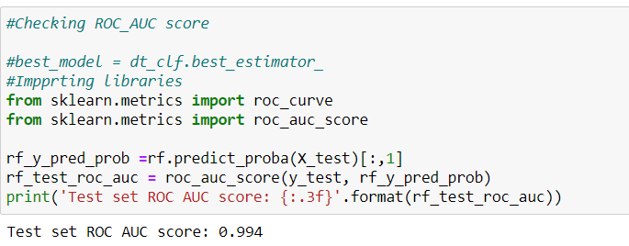
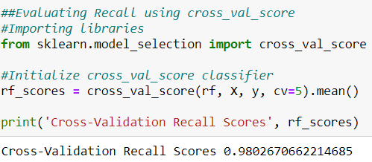
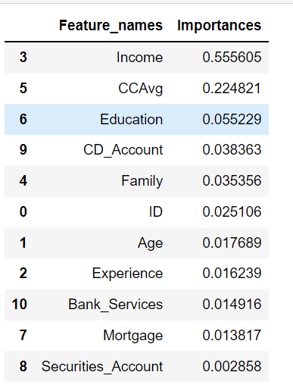
Random Forest AUC ROC Curve and Cross Validation
From ROC curve we have value of 0.99 which means that our model is good at predicting.
Cross Validation Recall score - 0.98

Slide 25
XGBOOST
XGBOOST Overview :
It’s a boosting ensemble method.
Boosting is a way to combine (ensemble) weak learners, primarily to reduce prediction bias.
Reasons for choosing :
XGBoost give great performance and accuracy both on regression and classification
XGBoost is fast. Really fast when compared to other implementations of gradient boosting
Different variations :
XGB_Model_1 (Unoptimized)
XGB_Model_2 (Hyperparameter tuning)
Observation on these models:
XGB_Model_1 (Unoptimized):
Recall is 0.9 little low than hypertuned model.
XGB_Model_2 (Hyperparameter Tuning ):
Recall is 0.92 after applying hyperparameter tuning using RandomizedSearchCV.
Cross-Val-score(0.984) is also better than other variations of XGboost
XGBoost Model - Conclusion:
Model built after performing hyperparameter tuning was more reliable. Therefore, we would be considering this model for further analysis.

Slide 26
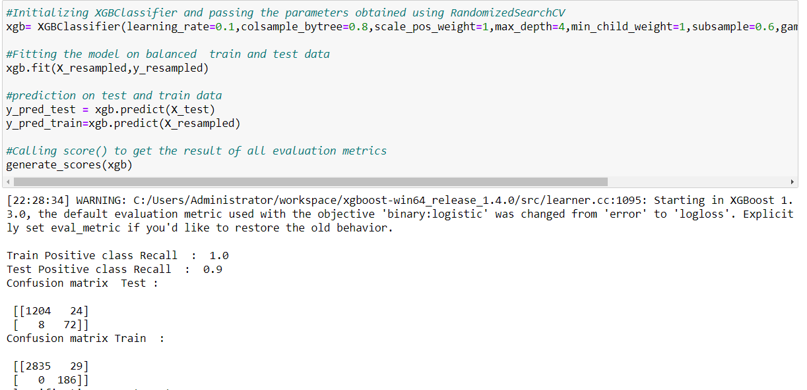
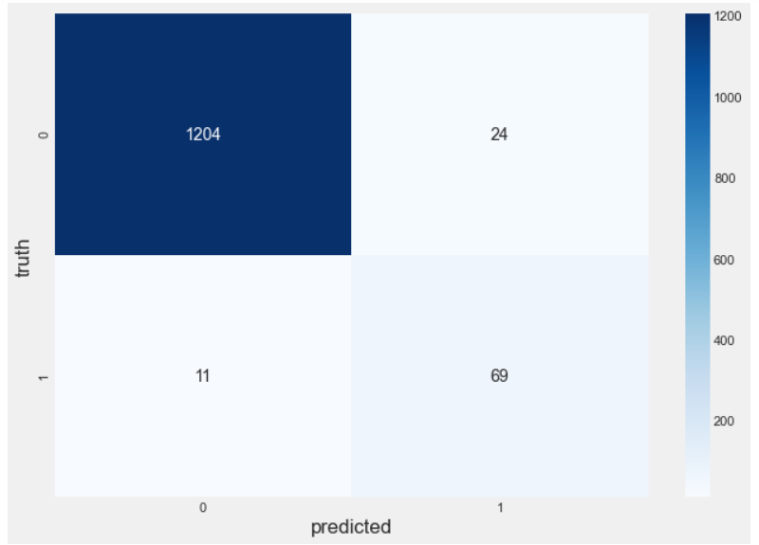
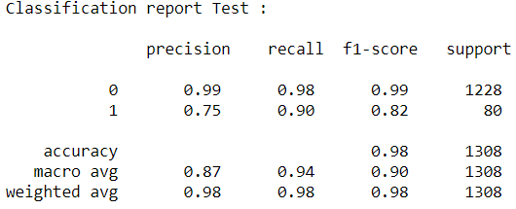
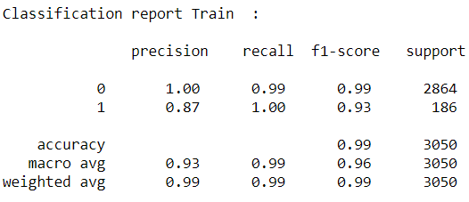
XGBoost Confusion Matrix
Interpretation of test confusion matrix:
Diagonal values represent accurate predictions, while non-diagonal predictions are not accurate. In the output, 1204and 69 are actual predictions and 24 and 11 are innacurate predictions.
True Positive from our matrix :69
True Negative from our matrix 1204
False Positive from our matrix :24
False Negative from our matrix :11
Recall :
Train Data :1.0
Test Data :0.9
We can see that Recall for both Train and Test are same. Hence, model build is not overfittting

Slide 27
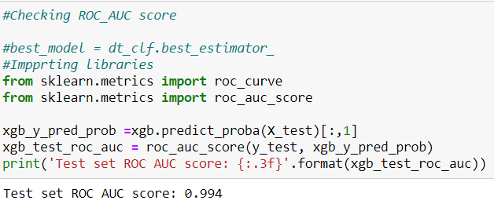


XGBoost AUC ROC Curve and Cross Validation
From ROC curve we have value of 0.99 which means that our model is good at predicting.
Cross Validation Recall score - 0.98

Slide 28



Comparision Of All Models
From the graph we can infer that Random Forest has the highest AUC score of 0.99 followed by XGboost, Logistic Regression, KNN and Decision Tree

Slide 29
Conclusion :
From the above, we can clearly see that Random Forest gave us best Recall of 96%.
Also, Type II(False Negative) errors are close to 2 in Random Forest model.
The area in ROC curve for Random Forest is 0.99 which is close to 1 which suggests that Random Forest is the best model in comparision to other models.
Cross-validation score is close to 0.98
Therefore, Random Forest would be the best choice for predicting whether customer would be interested in taking personal loan or not.
Actionable Insights & Recommendations :
As we have observed that Income is most important Feature, which indicates that Income has a good effect on Personal Loan, Customers with High Income have more chances of having Personal Loan. So it is advised to Target Customers with high income
CCAvg also show a good relationship with Personal Loan, which means customer who are spending more on credit cards can be targeted for Personal Loan
Since CD account has good relation with Personal loan, customers having CD account can be targeted for personal loans
Customers who has more family members can be targted for personal loan as well, since the relation between Family variable with personal loan is also good
Customer willing to have high mortgage value can also be targeted for personal loan
Customer whose Education level is high can be targeted for personal loan
Customer using addition bank services like Credit card or online doesn't have any significant impact on personal loan, so marketing/campaign team must not put more focus on such customers

Slide 30
Thank You

